Slide 1
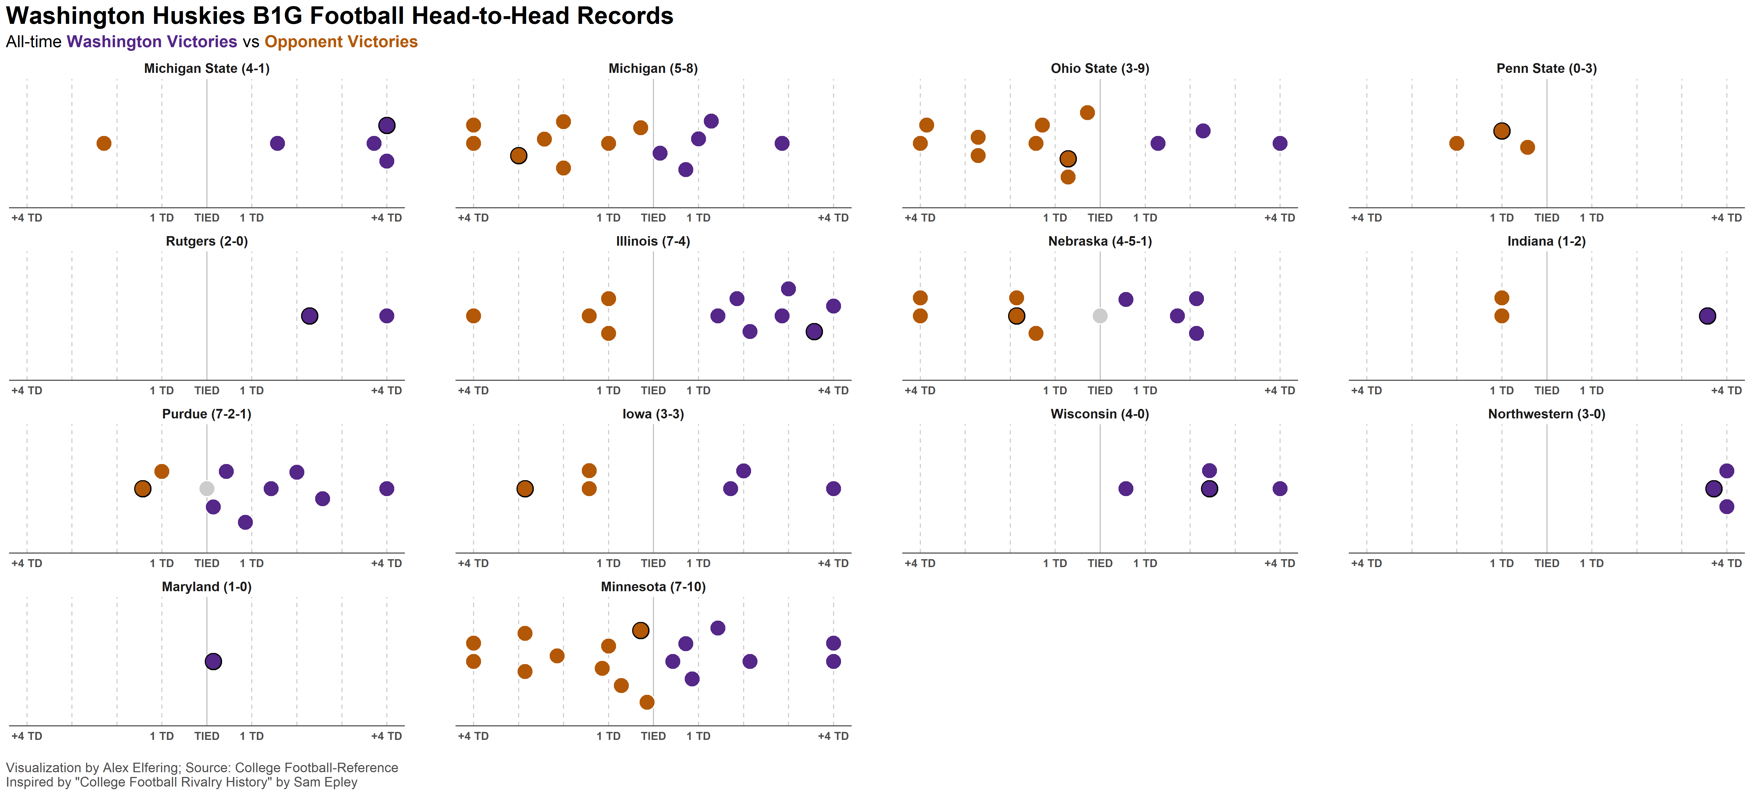
2023
2017
2021
2018
2017
2011
2003
2014
2002
1984
1995
1992
1977
1982

